Slide 1
parsing the excel
Siwei
2024.6

Slide 2
01
thinking about the algorithem
02
identify tables from big excel file and save as CSV
03
upload to AI
04
write a coomand line tool

Slide 3
Step 1: How to identify tables from a big excel?
pre-condition: no rule is given.
identify the excel file by AI?
failed .
only few AI provide this feature, not accurate, many mistakes
by data features? 根据数据特征来识别？
failed
by visiual features? 根据视觉来识别？
seems OK

Slide 4
step 2. implement the algorithem
write algorithm to parse the table from excel
identify the table’s left, top, bottom, right points.
should parse example0, 1, 2
basic algorithm:
each table has a blue-background-color header.
table formats are not uniformed/standard
some table has blank rows
some table has blank columns
some table headers are not next to each other, there are blank-color headers
some values are outside of the table
process speed: 3row/second

Slide 5
step 3: call the AI
chose kimi,
chatgpt seems not available in China.
support uploading files, multiple file
support history chat ( it will remember what we uploaded)

Slide 6
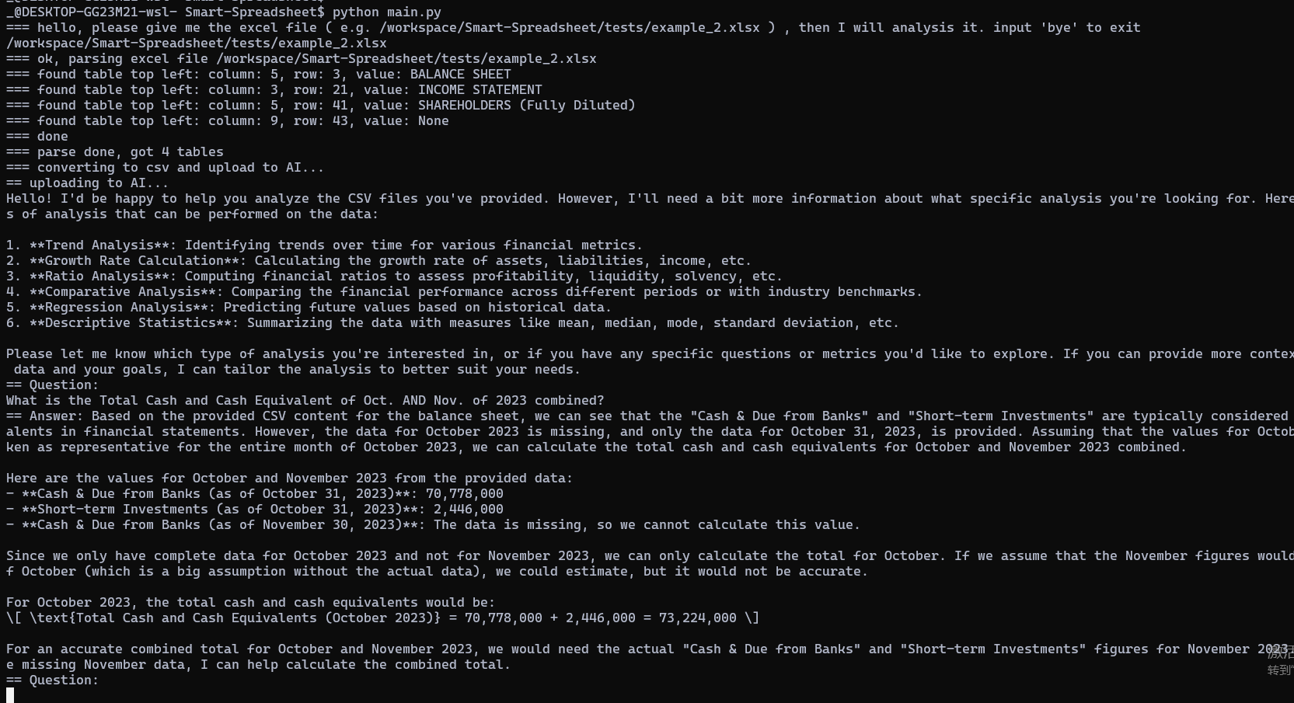
screenshot

Slide 7
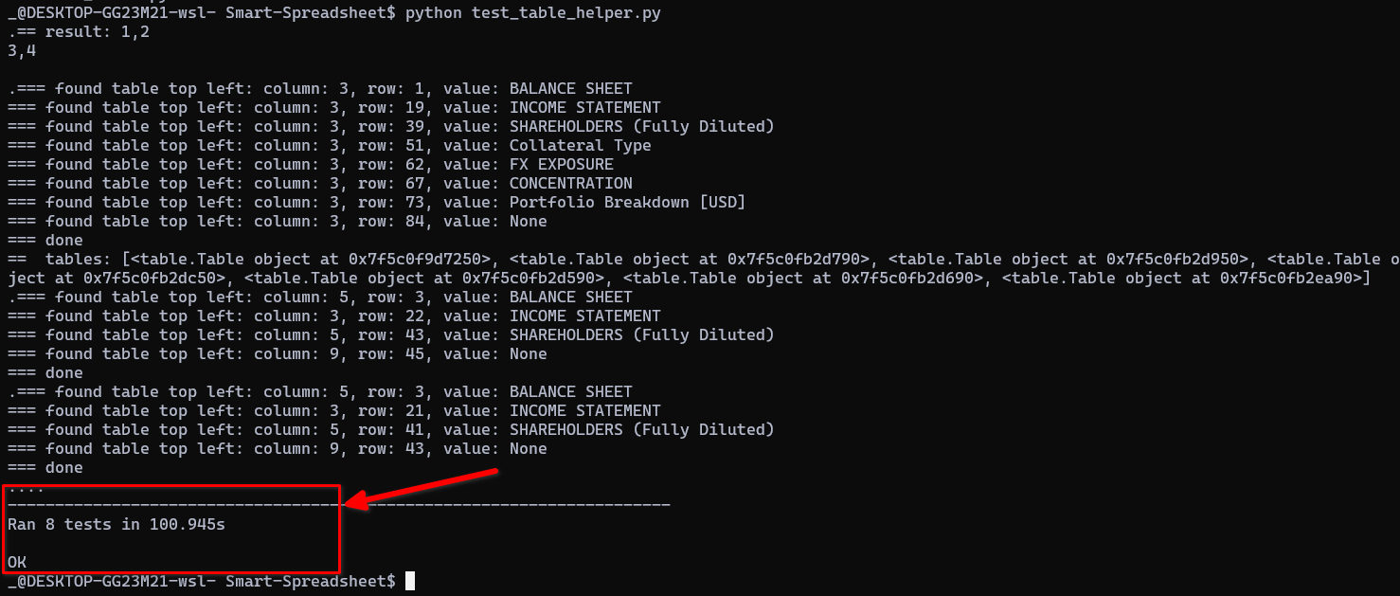
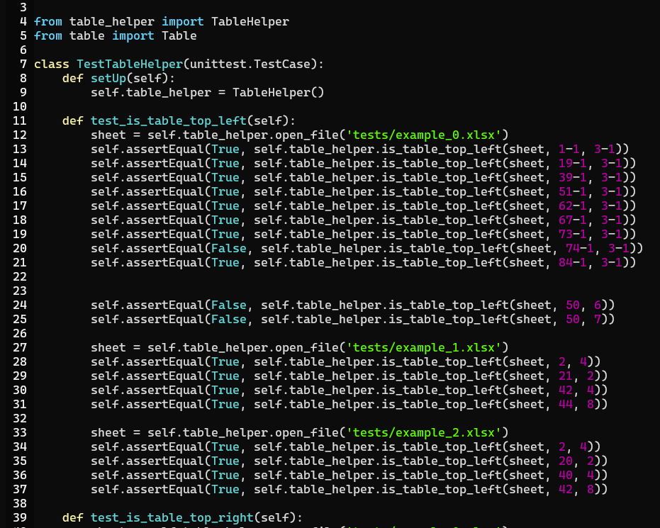
unit test: python test_table_helper.py

Slide 8
Time spent on each steps

